Slide 1
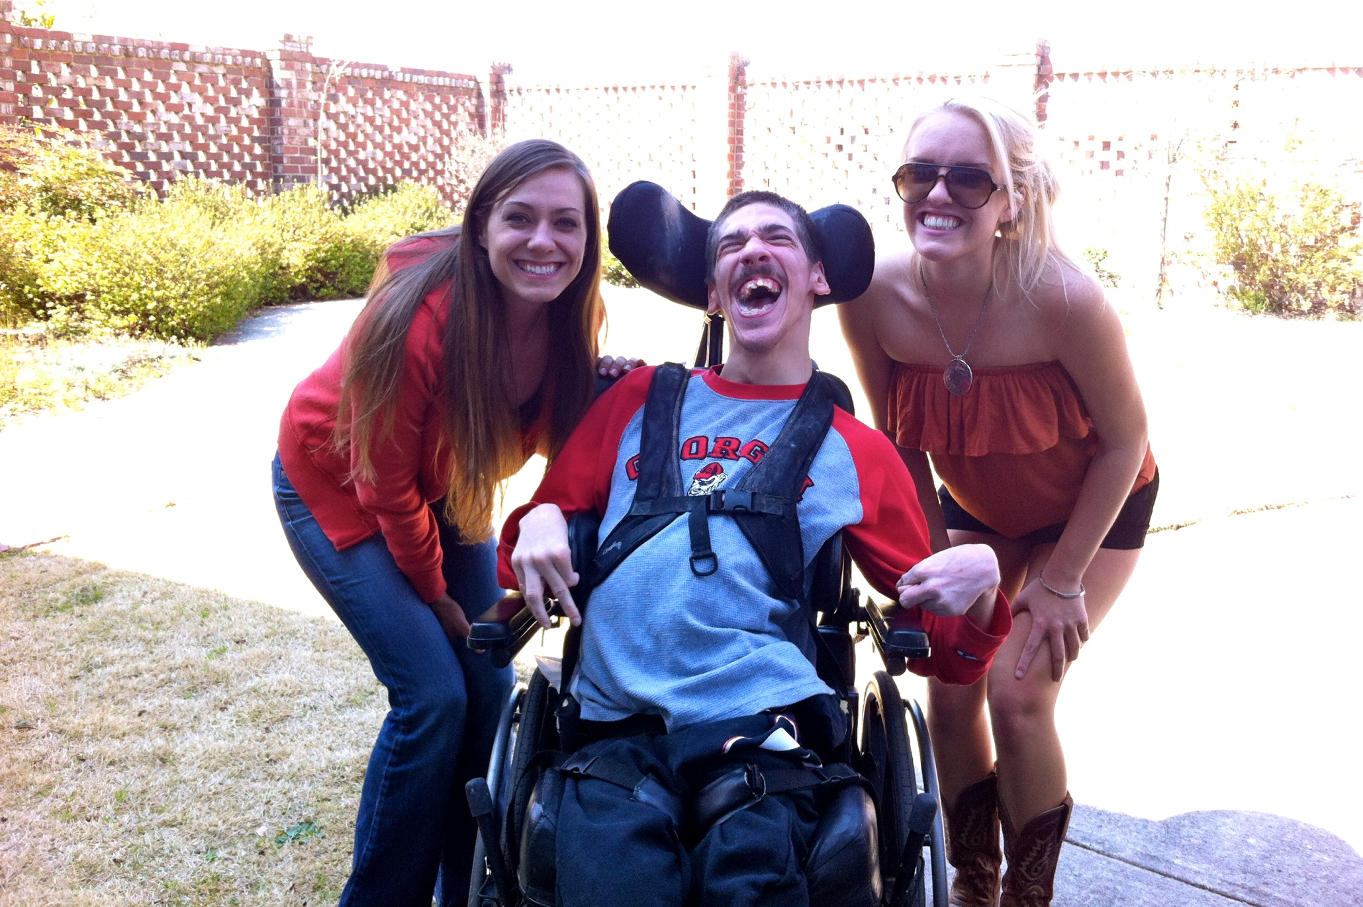
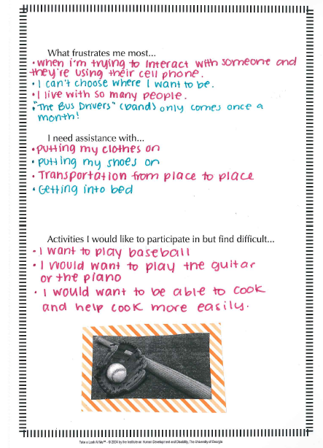
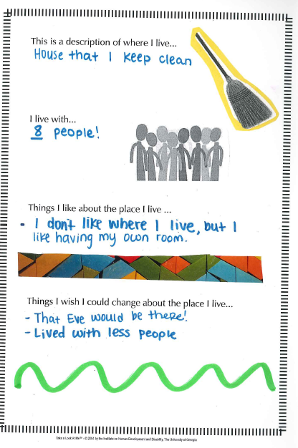
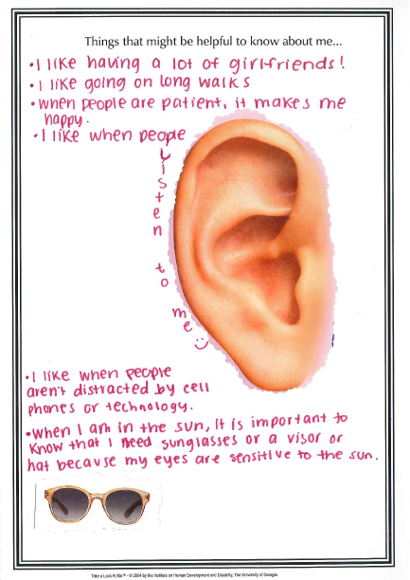
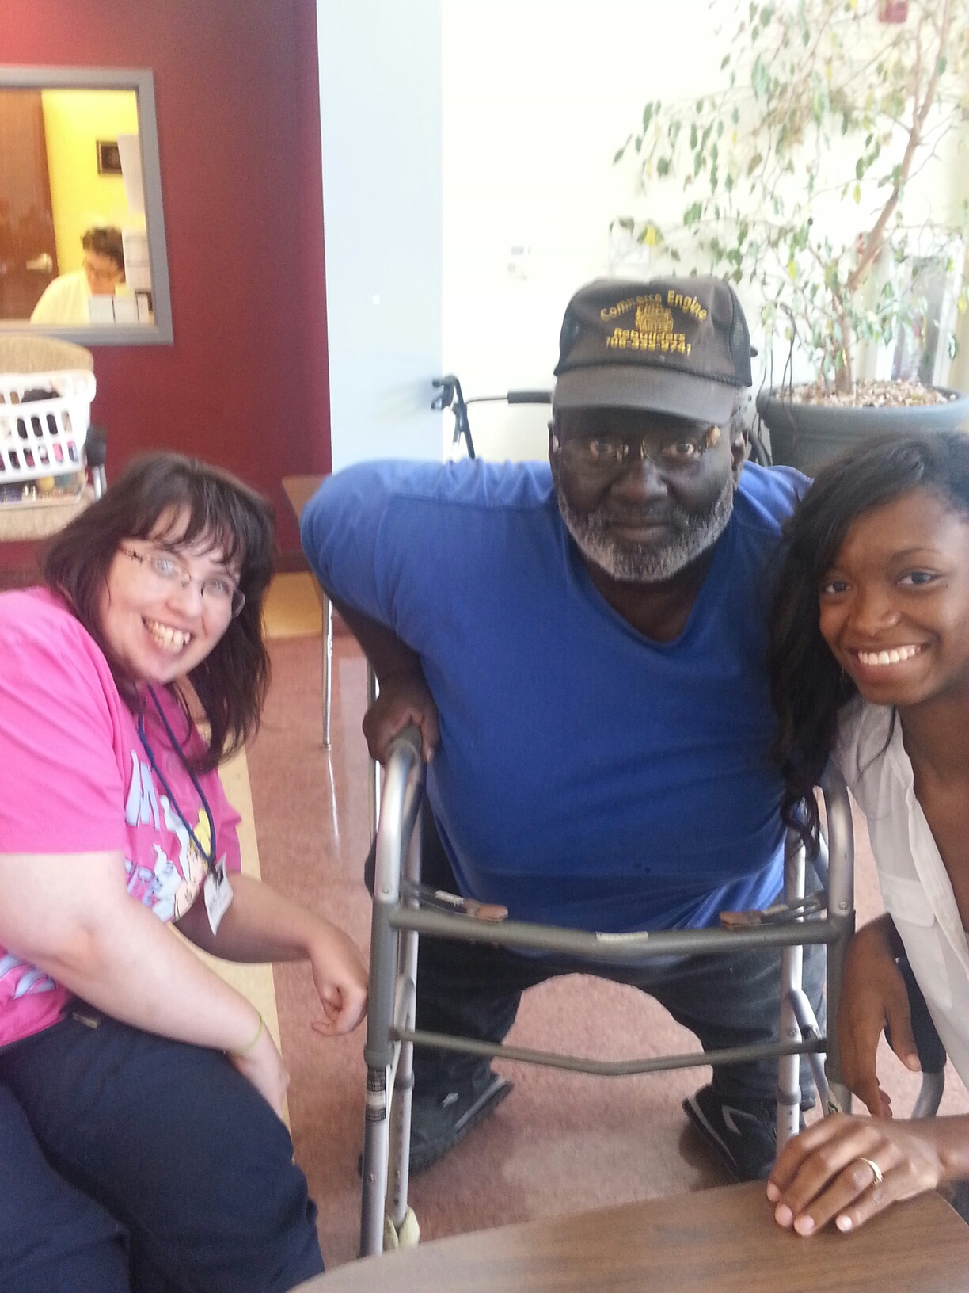
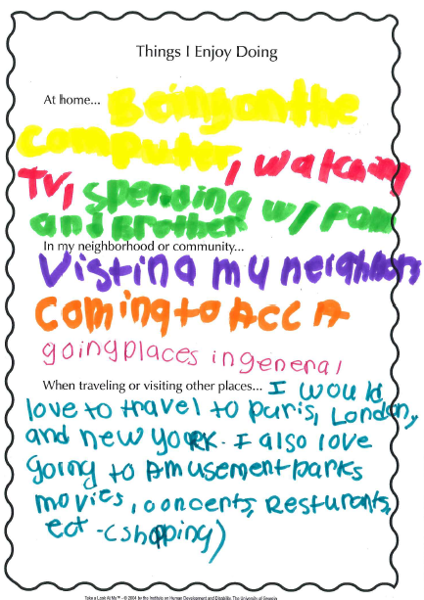
Enriching Undergraduate Education in Disability Studies Through
Service-Learning Engagement: A Pilot
Carol Britton Laws, PhD, MSW
Coordinator of Interdisciplinary Pre-Service Training,
The Institute on Human Development and Disability, UCEDD
Student Reflections
“After doing the portfolio with “R”, I realized that his goals in life were no different than most peoples. He wants to get married, have a job, and enjoy himself with activities like baseball and spending time outside. One thing that stood out to me while doing the project was that it is not “R” that is holding himself back, but the lack of supports and services are holding him back. Since learning about people with disabilities, I have noticed that I am able to treat people with disabilities just as everyday people rather than people to be pitied, feared, or looked down upon. Spending time with “R” gave me the opportunity to put what I have learned into practice.”
- B, Psychology, 2013
Service-Learning
Strengths-based Portfolio
“I learned that just because ‘R’ has a disability doesn’t mean he lets it get the best of him. From the outside looking in, I would expect ‘R’ to be miserable, depressed, and mad at the world if I only knew his story and had never met him. I couldn’t imagine not knowing my birthday, my parents, or being able to make my own decisions. However, ‘R’ is so happy, so appreciative, and ready to joke around at all times. He doesn’t let his disability or his situation get him down. I realized that no matter where you are in life, you are still going to have dreams and you are still going to dream big. I will never again judge someone’s happiness by their story or their abilities or disabilities”
. – C., Pre-Law, 2016
Service-Learning is a course-based, credit-bearing educational experience in which students participate in an organized service activity to meet identified community needs and reflect on the service to gain further understanding of course content and an enhanced sense of personal values and civic responsibility.
This pedagogy was applied to a course on Disability Issues in Adulthood (IHDD 4002).
Course learning goals met by the service-learning component of the course included:
Identifying social/environmental barriers to adult life for people with a disability.
Demonstrating knowledge of strengths-based approaches to understanding adults with disabilities.
Applying course material to understanding the lives of adults living with disabilities in our community.
Interacting with adults with disabilities in an age appropriate manner.
Challenging negative/ pitying attitudes toward adults with disabilities.
In our pilot, eight undergraduate students, from a variety of disciplines, provided 20 hours of service each to the Athens Area Community Council on Aging who had an expressed need for service in their day program. Students worked in pairs and completed strengths-based portfolios for four adults with disabilities who had volunteered to participate.
Developed at IHDD, the Take A Look At Me™ Portfolio is a 20+ page book designed to engage people with disabilities as they identify their own strengths, interests, and preferences. Through a series of open-ended questions with space for photos and artwork, this dynamic tool illuminates an individual's unique sense of self, and empowers individuals and others to reflect upon their hopes and dreams.
“We had a great time this semester partnering up with your students! I would have to say the entire thing was a resounding success. More than a couple of the students have formed lasting bonds with our clients, and some are going to continue volunteering with us on a regular basis, which I think is a real testament to the partnership’s impact on both the clients and the students. I enjoyed working with and getting to know your students. It’s also worth noting that your young people’s energy is contagious- not just to the client they were partnered with but to the whole center in general. Many of our older clients enjoy having young people around.
I can tell you without hesitation that we would love to partner again. I would say that this semester has been beneficial to all involved.”
-Thom Strickland, ACCA Activities Coordinator
“I have thoroughly enjoyed each and every one of my classes but my favorite part of the program was the service learning portion which allowed me to work hands-on with a person with a disability from the Athens Community Council on Aging. Getting to know this person was a new experience for me, and it helped me get out of my comfort zone.”
– A., Public Relations, 2013
Community Partner Reflection
‘B’ wants to get married, live on her own, and have her own family. I aspire to have this same dream and I think that she deserves it just as much as I do.”
- M., Journalism & Media, 2013
“Completing the portfolio, I realized that there are not many differences between adults and adults with disabilities. We both share common responsibilities and interests; however, it is disheartening when people with disabilities are deemed unable to accomplish these responsibilities. ‘C’ helped me realize how silenced people with disabilities are - especially him -since he is unable to verbally express himself. This fueled my interest and desire to advocate for people with disabilities as I matriculate to law school. Outside of decorating a scrapbook about ‘C’s preferences, needs, likes, and dislikes, I became more visually aware of the importance of one’s quality of life. Seeing ‘C’ smile everyday that I volunteered made me realize how I had affected his life. More importantly, he has changed mine.”
– B., English, 2014

